Slide 1
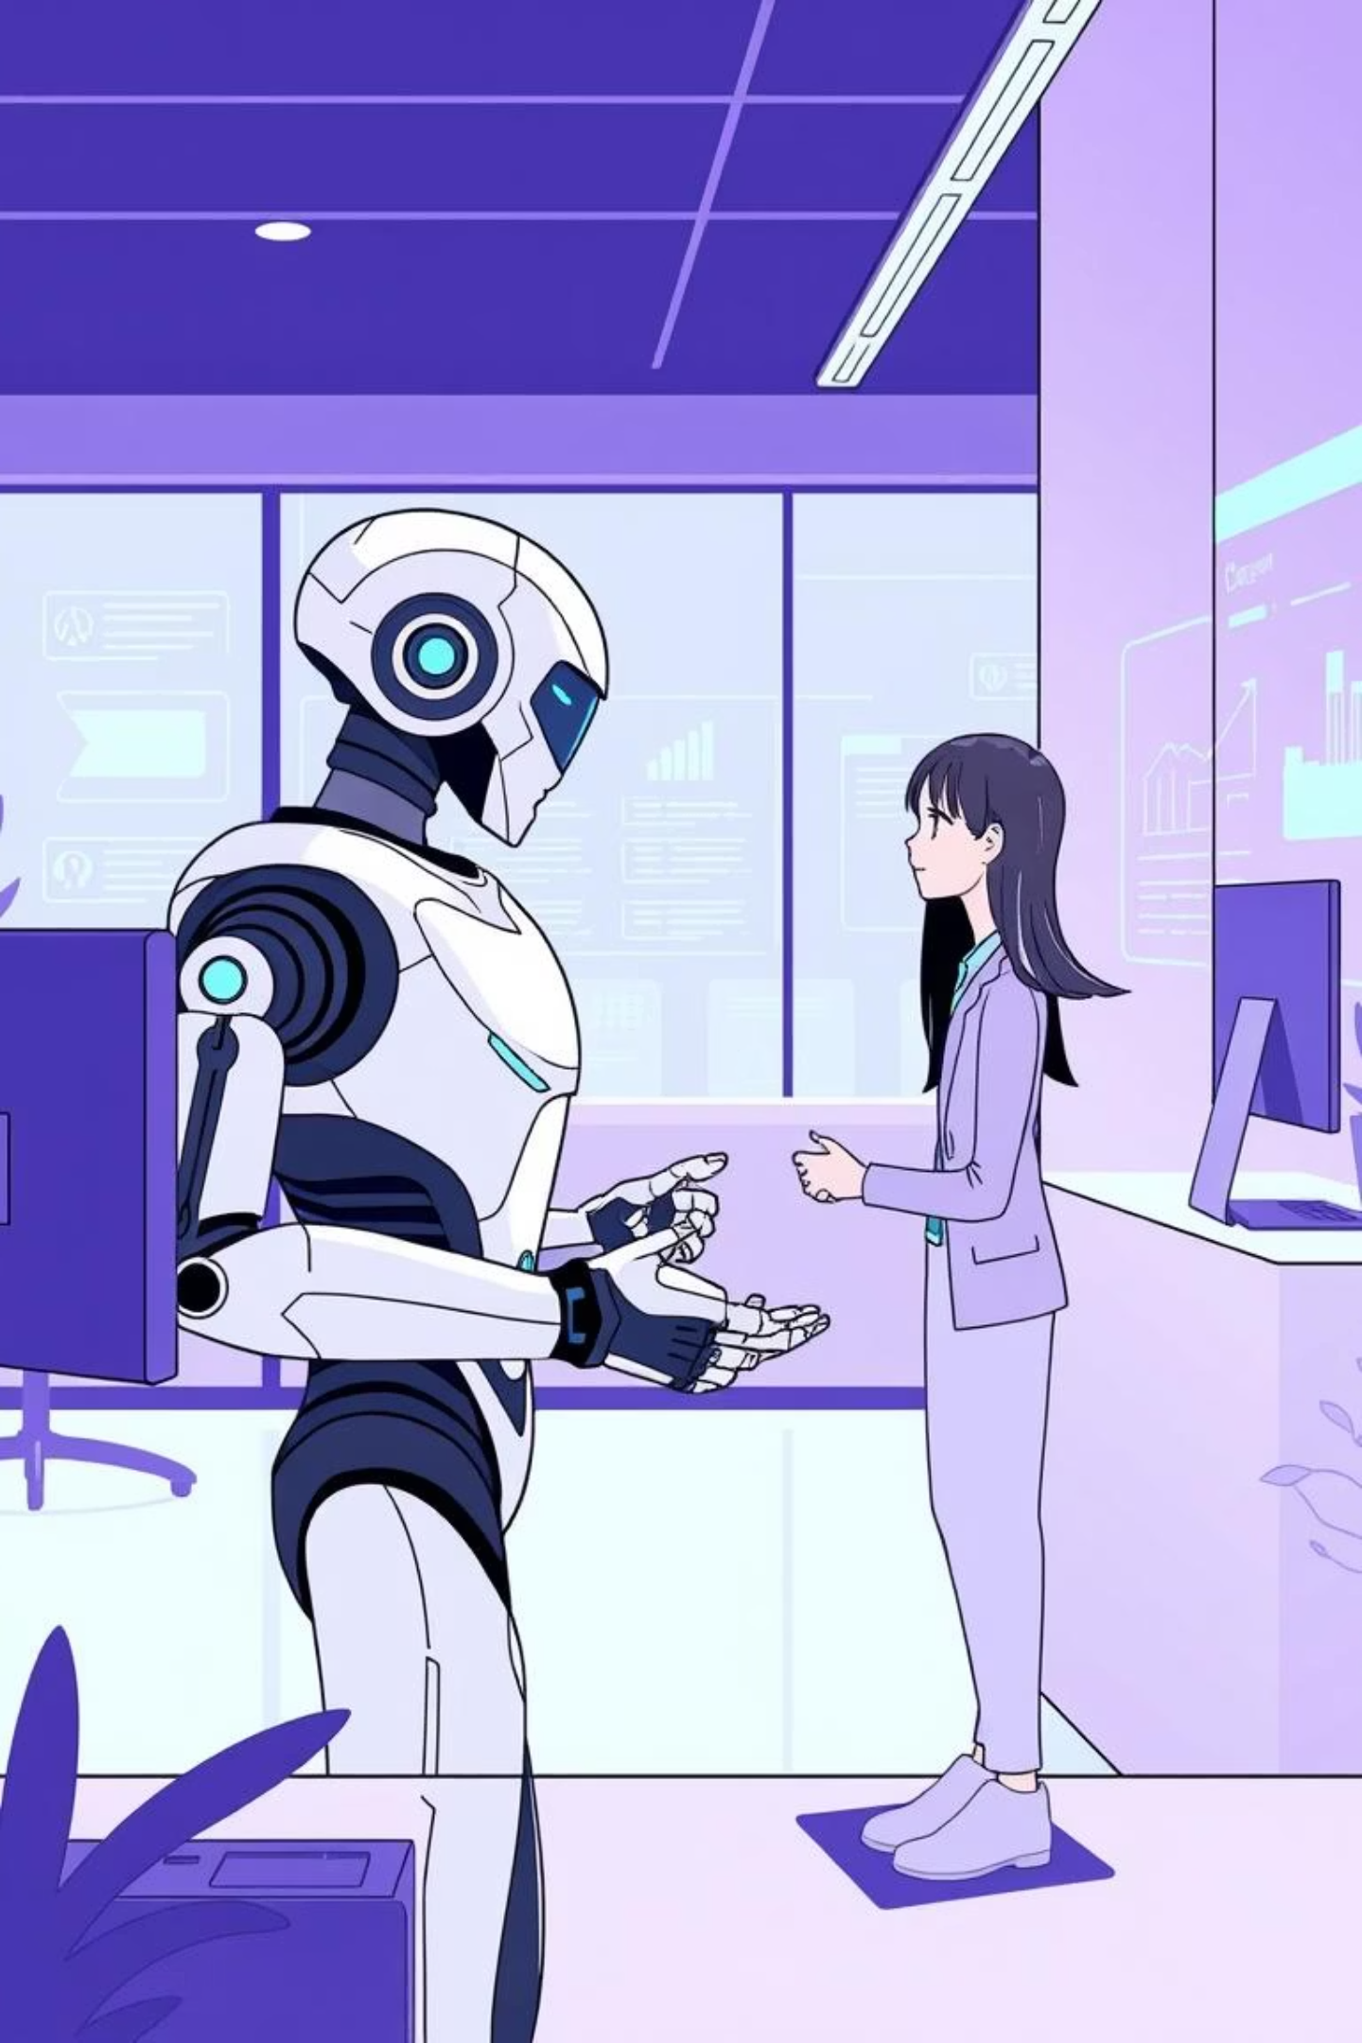
AI-Driven Chatbot for Intelligent Customer Service Automation
Guided by:
Dr. NAGARAJAN M.K
(ASP/CSE – KARE)

Slide 2
Team Details:
S.NO | NAME | REG.NO
1. | Md Tufail Raza | 99220040629
2. | Ganesh Kumar Sardar | 99220040512
3. | Uttam Kumar | 99220041404
4. | Rajesh Janapati | 99220040976
Team - 03

Slide 3
Introduction:
In the modern digital era, customer service has become a key factor in business success.
Customers demand instant, personalized, and 24/7 support, which traditional methods struggle to provide efficiently.
Businesses face challenges with high operational costs, long wait times, and limited scalability when relying solely on human agents.
AI-driven chatbots have emerged as a powerful solution, leveraging Natural Language Processing (NLP), Machine Learning, and automation to enhance customer service.
These systems not only resolve repetitive queries automatically, but also improve customer satisfaction, reduce costs, and increase overall efficiency.

Slide 4
Problem Statement:
Traditional customer support systems often face significant challenges such as long response times, high operational costs, and limited scalability, which directly affect customer satisfaction and business efficiency. Rule-based chatbots, although introduced as a solution, are restricted by predefined scripts and lack the flexibility to handle dynamic or complex queries, resulting in incomplete or unsatisfactory interactions.
These limitations highlight the growing need for an intelligent, adaptive, and cost-effective solution that can efficiently manage high volumes of queries, deliver personalized and accurate responses in real time, and enhance the overall customer experience while reducing the dependency on human agents.

Slide 5
Literature Survey:
Author / Year | Focus Area | Findings | Gap Identified | Reference Link
Pamungkas (2019) | Emotionally-Aware Chatbots | Early systems add emotion detection to NLP | Limited emotion nuances and adaptability | [Link] (arXiv)
Richardson & Heck (2023) | Commonsense Reasoning in AI | Contextual reasoning remains limited in LLMs | Struggle with commonsense, coherent dialogue | [Link] (arXiv)
Adelusi (2022) | Hybrid Chatbot Architectures | Combines rule-based and ML—better accuracy and usability | Scalability and integration challenges | [Link] (ResearchGate)

Slide 6
Literature Survey:
Author / Year | Focus Area | Findings | Gap Identified | Reference Link
Adelusi (2022) | Hybrid Chatbot Architectures | Combines rule-based and ML—better accuracy and usability | Scalability and integration challenges | [Link] (ResearchGate)
Izadi (2024) | Error Correction in Conversational AI | Feedback loops and RL boost reliability | Combating factual errors and bias remains tough | [Link] (MDPI)
Singh (2025) | Large Language Models in Chatbots | LLMs bring richer performance and evaluations | Testing and consistency gaps remain | [Link] (ScienceDirect)

Slide 7
Existing System Overview
Existing customer service systems include:
Manual support systems requiring human agents
Rule-based chatbots with limited responses
Cloud-based AI chatbots dependent on APIs
Limitations:
High operational cost
Dependency on internet and APIs
Limited scalability in rule-based systems
Slow response time in manual systems

Slide 8
Proposed System:
The objective of this project is to develop an AI-driven chatbot that automates routine queries and processes, thereby reducing response times and minimizing the need for manual intervention. By leveraging natural language processing and contextual understanding, the chatbot aims to provide real-time, personalized customer support tailored to individual needs.
This will not only optimize workforce efficiency by offloading repetitive tasks and allowing human agents to focus on complex, high-value interactions but also ensure a scalable and cost-effective customer service model capable of handling growing user demands while maintaining high levels of accuracy, reliability, and customer satisfaction.

Slide 9
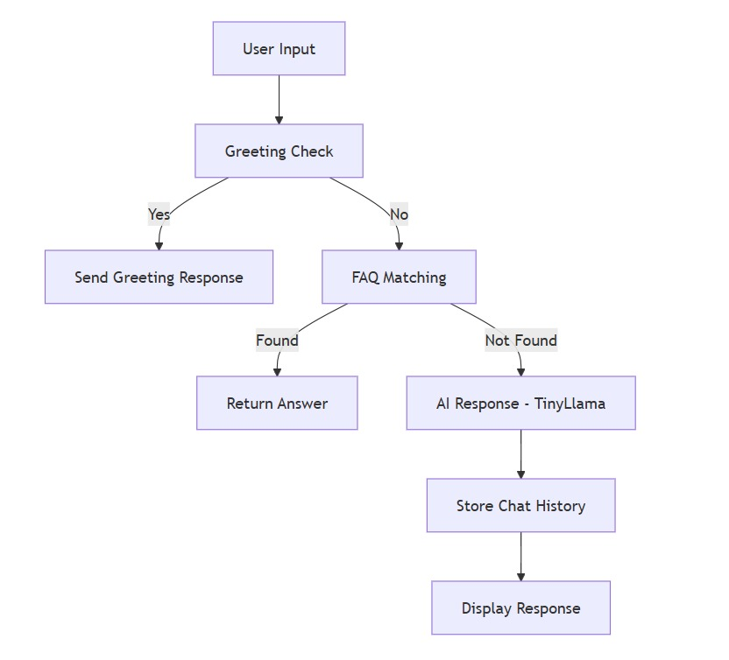
Methodology:
System Working Process
Step 1: User InputUser sends query through the web interface.
Step 2: Greeting DetectionSystem checks if input is a greeting → returns predefined response.
Step 3: FAQ Matching (Database Layer)Exact match searchSimilar match using SQL LIKE queryIf match found → instant response.
Step 4: AI Fallback (TinyLlama via Ollama)If no FAQ match →Retrieve chat historyGenerate intelligent response using local LLM.
Step 5: Store & Return ResponseSave user query + bot reply in MySQLMaintain session-based chat history.
SYSTEM OVERVIEW DIAGRAM

Slide 10
Algorithm / Tools Used:
Algorithms:
Step-by-Step Algorithm
Receive user message from frontend
Preprocess inputConvert to lowercaseRemove extra spaces
Greeting CheckIf greeting → Return predefined response
FAQ MatchingSearch exact match in databaseIf found → Return FAQ answer
Similar FAQ SearchUse SQL LIKE queryIf match found → Return database answer
AI Fallback (TinyLlama via Ollama)Retrieve session chat historyBuild
contextGenerate AI response
Tools & Technologies:
BackendJavaSpring Boot
Spring Data JPAHibernate🔹 DatabaseMySQL🔹 AI ModelOllama (Local LLM Runtime)TinyLlama Model🔹 Frontend - HTMLCSSJavaScript🔹 Development ToolsMaven - VS Code /

Slide 11
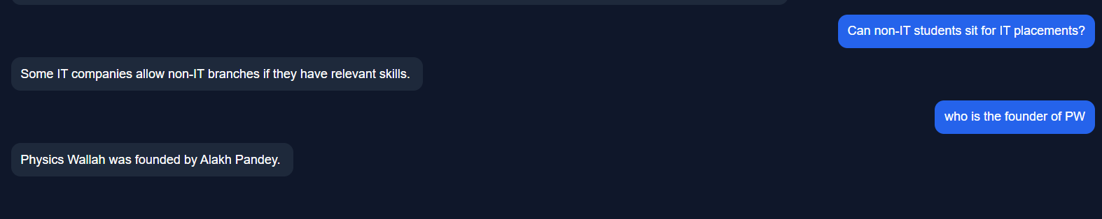
Implementation Screenshot

Slide 12
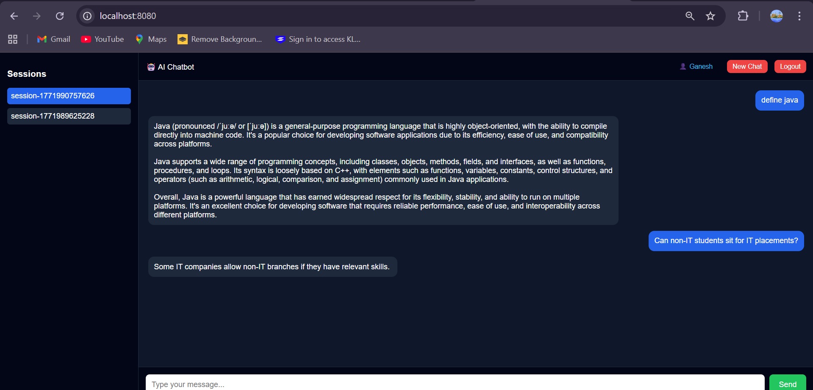
Output

Slide 13
Conclusion:
Automates routine customer queries efficiently
Provides real-time, personalized support
Reduces human agent workload
Scalable and cost-effective solution
Continuously learns to improve accuracy and performance
Enhances overall customer satisfaction and business efficiency

Slide 14
Future Scope:
Enable voice-based interactions for chatbots
Incorporate emotion and sentiment analysis for smarter responses
Use predictive analytics for proactive customer engagement
Expand to multi-lingual and cross-platform support for global users

Slide 15
References:
Pamungkas, F. (2019). Emotionally-Aware Chatbots for Customer Interaction. arXiv: https://arxiv.org/pdf/1906.09774.pdf
Richardson, E., & Heck, L. (2023). Commonsense Reasoning in AI Chatbots. arXiv: https://arxiv.org/pdf/2302.07926.pdf
Adelusi, O. (2022). Hybrid Rule-Based and Machine Learning Chatbots. ResearchGate:https://www.researchgate.net/publication/387669510_Hybrid_RuleBased_and_Machine_Learning_Chatbots
Izadi, H. (2024). Error Correction in Conversational AI. MDPI AI Journal: https://www.mdpi.com/2673-2688/5/2/41/pdf
Singh, R. (2025). Large Language Models in Chatbots. ScienceDirect: https://www.sciencedirect.com/science/article/pii/S2949719125000044/pdfft
Jurafsky, D., & Martin, J. H. (2023). Speech and Language Processing (3rd ed.). Pearson.
Khatri, C., & Sharma, P. (2022). AI Chatbots in Customer Service: Trends and Challenges. International Journal of AI Research.

Slide 16
Paper Preparation/Status:
Our team successfully completed a research paper titled 'AI-Driven Chatbot for Intelligent Customer Service Automation', adhering to IEEE formatting guidelines.
The paper was thoroughly checked for plagiarism and submitted to multiple academic conferences for review and presentation.
Our paper got accepted in ICDSMLA 2025 and we had also presented our paper in this conference and in 2-3 months it will get published

Slide 17
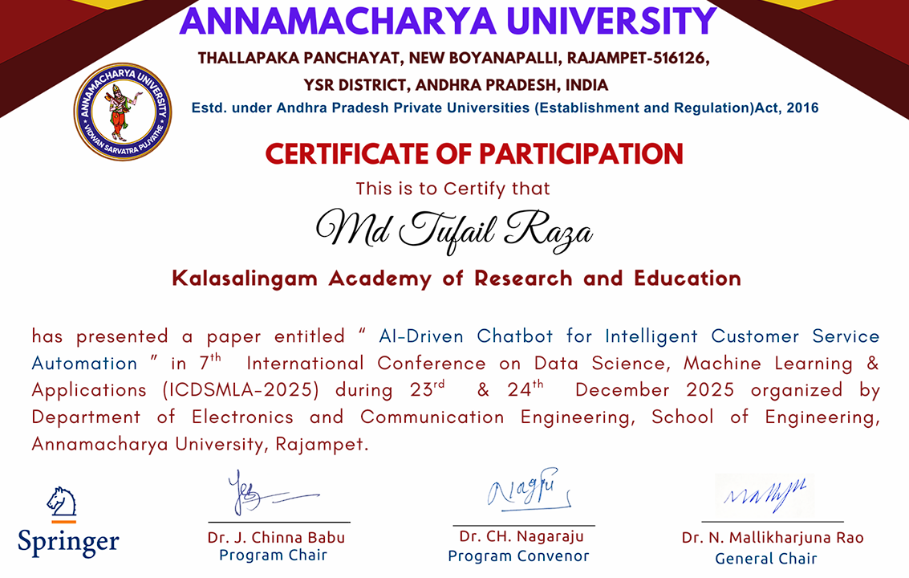
Participation Certificate:

